Slide 1


Autism predictor
Tech Ninjas
Challenge – AI and ML
the Frontier of ADVANCED TECHNOLOGY IN Health Care

Slide 2


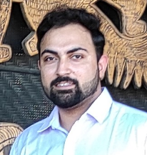


TECH Ninjas
Pic
Pic
Pic
Nibedita Jena
OGA India, Bangalore
Ipsita Pattanayak
OGA India, Bangalore
Aashutosh Nanda
OGA India, Noida
Sr Data Engineering Analyst
Data Engineering Analyst
Data Engineering Analyst
Pic
Pic
Nirupama Kushwaha
OGA India, Noida
Gurjot Sabharwal
OGA India, Noida
Data Engineering Analyst
Assoc Data Engineering Mgr

Slide 3
Problem statement and solution
Problem Statement:
Autistic Spectrum Disorder (ASD) is a neurodevelopment condition associated with significant healthcare costs, and early diagnosis can significantly reduce these. Unfortunately, waiting times for an ASD diagnosis are lengthy and procedures are not cost effective.
The economic impact of autism and the increase in the number of ASD cases during this time of pandemic across the world reveals an urgent need for the development of easily implemented and effective screening method.
Solution:
Autism Predictor, An AI/ML enabled webapp which is designed to get instant and preliminary prediction of the disorder without the need to go to a healthcare professional.
It is a time-efficient and accessible ASD screening webapp, which is imminent to help health professionals and inform individuals whether they should pursue formal clinical diagnosis or not. It will help for early diagnosis in a cost-effective way.

Slide 4
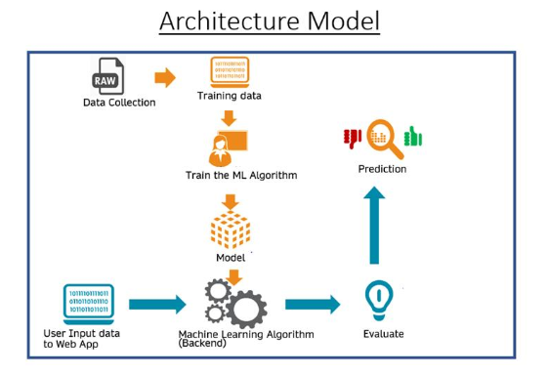
Solution model

Slide 5
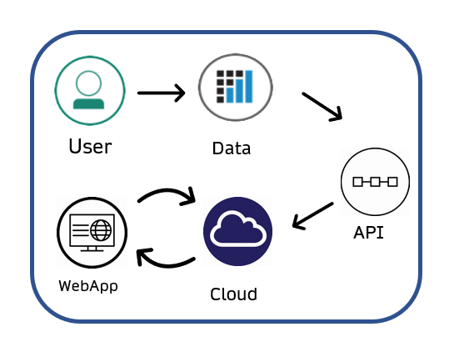
Demonstration and roadmap
Roadmap:
As this webapp is invaluable in autism awareness and instant
assistance to predict it, we will work on deploying it in cloud.
In future, this application can be integrated with IoT devices
which will improve operational efficiency and affordability in
medical field.
Demonstration:
Please watch the demonstration of the WebApp Autism Predictor in the video file submitted on the Hackathon Page.

Slide 6
Thank You

